Slide 1

Scientific Computing with the NAG Toolbox for MATLAB
John Muddle
UK Academic Account Manager
NAG Ltd, Oxford
December 1st 2015

Slide 2
NAG at Sheffield University
Unlimited use under Linux, Windows and Mac (32-bit and 64-bit)
  As long as for academic or research purposes
  Installation may be on any university, staff or student machine
Products
  All NAG Libraries: Fortran, C, SMP, Python, Java, .NET, Toolbox for MATLAB
How do you get the software?
  Help yourself from: http://www.nag.co.uk/downloads/index.asp
  Request licence keys via support@nag.co.uk using your university e-mail address please e.g. xxxx@sheffield.ac.uk
Full access to NAG Support
  Send support requests to support@nag.co.uk

Slide 3
Objectives of today
Aim to:
Extend your practical MATLAB programming abilities
Gain an overview of the contents of the NAG mathematical library
Understand how to find information about relevant NAG routines
Use NAG routines in helping to solve simple but realistic problems

Slide 4
Slides
These slides are available as PowerPoint or PDF:
http://monet.nag.co.uk/nag_toolbox_training/sheffield/MATLAB

Slide 5
Introduction to NAG
Numerical Algorithms Group - Founded 1970
  Co-operative software project: Birmingham, Leeds, Manchester, Nottingham, Oxford, and Atlas Laboratory
Incorporated as NAG Ltd. in 1976
  Not-for-profit
  Based in Oxford, with offices in Manchester, Chicago, Tokyo
Notes:
30-Nov-15
NAG Confidential
5
$10m
Majority of developers in Oxford
World-wide support around the clock

Slide 6
What do NAG do?
Mathematical algorithm development
  Collaboration
Software engineering – production of software libraries
HPC services
Consultancy
Implementation / porting

Slide 7
A definition of Numerical Analysis
“The study of methods for obtaining approximate solutions to mathematical problems” – T. Hopkins and C. Phillips, 1988
  But beware of assuming that “approximation” is a pejorative term

Slide 8
What are numerical analysts concerned with?
Accuracy of algorithms
  Problems due to floating-point arithmetic
  Error analysis - how are errors propagated?
Stability
  Sensitivity of a computed solution to changes in input data
Efficiency
  Which methods avoid unnecessary computation?
Speed
  Desirable – but beware – “how fast do you want the wrong answer?”

Slide 9
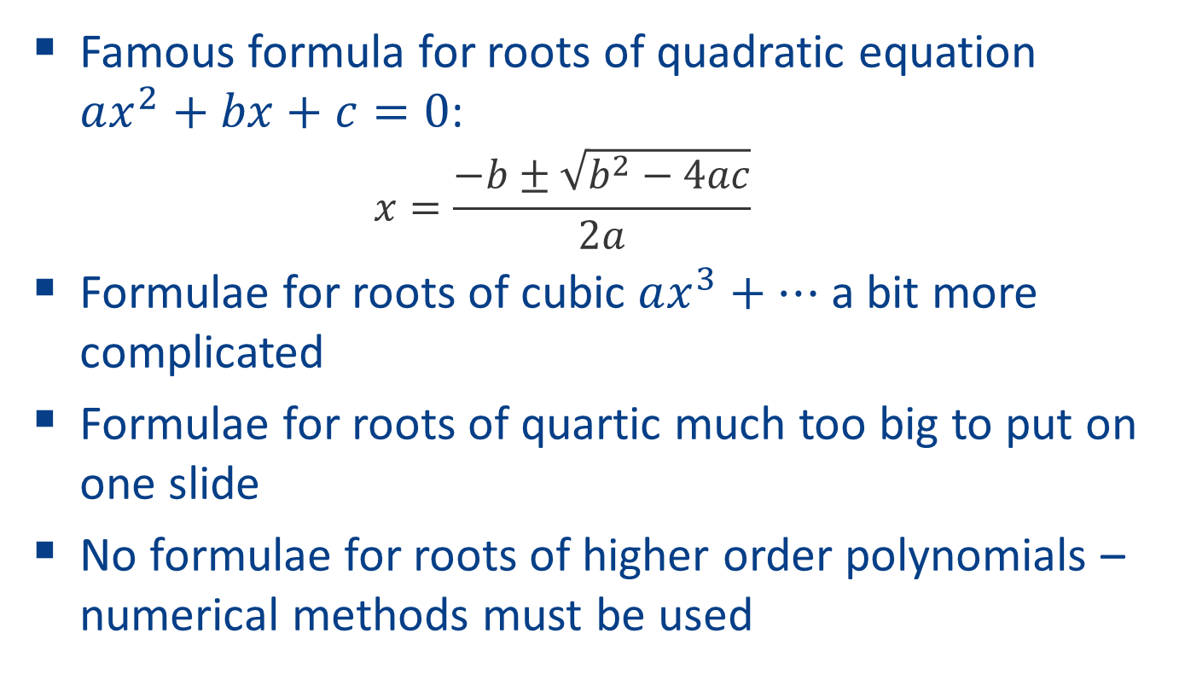
Why use numerical methods?
A simple example: roots of polynomials
Famous formula for roots of quadratic equation $ax^{2}+bx+c=0$:
  $$x=\frac{−b±\sqrt{b^{2}−4ac}}{2a}$$
Formulae for roots of cubic $ax^{3}+…$a bit more complicated
Formulae for roots of quartic much too big to put on one slide
No formulae for roots of higher order polynomials – numerical methods must be used
Notes:
With quadratic formula, need to take care, e.g. when b^2 >> 4ac
In fact a numerical method might use the quadratic formula, but not in exactly that form
Probably will not use the formulae for order 3
Will not use the order four formulae

Slide 10
How do we decide what goes into libraries?
Typically we get functionality requests from customers
  via technical support calls
  via salespeople
We maintain a database of requests
Probability of responding is weighted by number of requests, importance of customers, and difficulty of job

Slide 11
What’s so hard about that then?
Computer arithmetic makes things tricky.
Many people assume that computers are completely accurate when it comes to operations on real numbers.
  Usually they are not!
  Numbers have finite precision
  Also a finite size
  They are subject to rounding error.
e.g. on a (hypothetical) decimal machine with 3 digits:
a = 5.55 b = 6.56 c = 12.1
a+b-c = 0.00 (due to rounding) instead of 0.01 in exact arithmetic
We must also worry about overflow and underflow

Slide 12
Example: PDF of Gamma Distribution
Probability density function (PDF)
looks easy to evaluate. But, depending on a, b and x, any of the quantities
might overflow or underflow, even if the end result is in a reasonable range.
Program code to check all contingencies can become monstrous!

Slide 13
We also have to worry about performance
Tune up code
  Use benchmarking programs
  Use high-performance math libraries like ACML or MKL where possible
Investigate possibilities for parallelism
  OpenMP (for NAG SMP Library)
  MPI (for NAG Cluster Parallel Library)
But correctness is most important
  How fast do you want the wrong answer?

Slide 14
Why is software testing important?
Six reasons not to test:
“It takes too long – I’ve no time to do it”
  Fine – but be aware it may take longer later
“It costs too much”
  It generally costs more to fix things later
“This code will only be used for a short time”
  That’s what they said about Windows notepad
“My code always works first time”
  You’ve got to be kidding
“It’s someone else’s responsibility”
  Bad attitude!
“I’m starting a new job next month”
  Let’s hope you don’t last long in that one either

Slide 15

A Famous Software Bug
Ariane 5 rocket explodes (June 1996)
The Ariane 5 rocket exploded on its maiden flight because the navigation package was inherited from the Ariane 4 without proper testing. The new rocket flew faster, resulting in larger values of some variables in the navigation software. Shortly after launch, an attempt to convert a 64-bit floating-point number into a 16-bit integer generated an overflow. The error was caught, but the code that caught it elected to shut down the subsystem. The rocket veered off course and exploded. (Kernighan, 1999)
A successful launch in 2007
www.space.com/imageoftheday/image_of_day_070316.html
Credit: Arianespace. www.arianespace.com

Slide 16
The NAG Engine
NAG C
Library
NAG Fortran
Library
NAG Engine
(algorithm
repository)
User-callable library routines are thin wrappers
NAG Toolbox for MATLAB
NAG SMP
Library
etc.

Slide 17
NAG Toolbox for MATLAB – Mark 24
Root Finding
Summation of Series
Quadrature
Ordinary Differential Equations
Partial Differential Equations
Numerical Differentiation
Wavelets
Integral Equations
Mesh Generation
Interpolation
Curve and Surface Fitting
Optimization (local and global)
Approximations of Special Functions
Dense and sparse Linear Algebra
Option pricing
Correlation and Regression Analysis
Nearest correlation matrix
Multivariate Analysis of Variance
Random Number Generators
Univariate Estimation
Nonparametric Statistics
Smoothing in Statistics
Contingency Table Analysis
Survival Analysis
Time Series Analysis
Operations Research

Slide 18
Installation of the NAG Toolbox
Get a version of the NAG Toolbox appropriate to your copy of MATLAB from:
http://www.nag.co.uk/downloads/mbdownloads.asp
You will need a licence key – try the first one below:
MBW6I24DD TRIAL 2016/01/04 "R6kunal0pgtbWdaflgu1iwmkIR"
MBW3223DC TRIAL 2016/01/04 "60gn+ddIimgk40lKGnZSg2+kEz"
MBL6A24DN TRIAL 2016/01/04 "ChghxpANiuHo3xiJ1dRDoEhluk"
MBMI624DD TRIAL 2016/01/04 "9XhGMe8Ba=+ptxgYnlt4eDYeON"

Slide 19
Check correct installation
To check that you have the NAG Toolbox installed, in MATLAB command window type a00aa
To check you have the licence key installed, type a00ac
(return value 1 indicates key found).

Slide 20
NAG Toolbox for MATLAB
The NAG Toolbox (like all NAG libraries) is divided into chapters, each devoted to a branch of mathematics or statistics. Each has a 1 or 3-character name and a title
  e.g. S – Special Functions or F03 – Determinants
All routines in the Toolbox have five-character names, beginning with the characters of the chapter name, e.g. d01aj.
There are also long names that are more descriptive – e.g. c02ag() = nag_zeros_poly_real()

Slide 21
NAG Toolbox for MATLAB
Documentation has an informative introduction to each chapter:
  Technical background to the area.
  Assistance in choosing the appropriate routine
And a document for each routine with:
  Description of method and references
  Specification of arguments
  Explanation of error exit
  Remarks on accuracy
  An example to illustrate use of routine, some enhanced with graphics

Slide 22
NAG Documentation
Documentation is available through the MATLAB help system.
In newer versions of MATLAB the NAG documentation may be a little harder to find. Click the F1 key, then choose “Supplemental Software”, then open the “NAG Toolbox” folder
You can also find NAG Toolbox documentation online:
  www.nag.co.uk/numeric/MB/manual64_24_1/html

Slide 23
NAG Toolbox for MATLAB
Let’s take a look ...
Notes:
< show help >
< help contents >
< chapter intros >
< example prog here >

Slide 24
A Simple Example
Here is an example of how to use the NAG Library to compute the solution of a real system of linear equations, Ax = b, where A is an n by n matrix and x and b are n vectors.
a = [ 1.80, 2.88, 2.05, -0.89;
5.25, -2.95, -0.95, -3.80;
1.58, -2.69, -2.90, -1.04;
-1.11, -0.66, -0.59, 0.80];
b = [ 9.52; 24.35; 0.77; -6.22];

Slide 25
A Simple Example
And we call it like this:
Here the NAG routine f07aa takes two arguments, the matrix of coefficients, A, and the vector representing the right-hand side, b.
[lu, ipiv, x, info] = f07aa(a, b);
x
x =
1.0000
-1.0000
3.0000
-5.0000

Slide 26
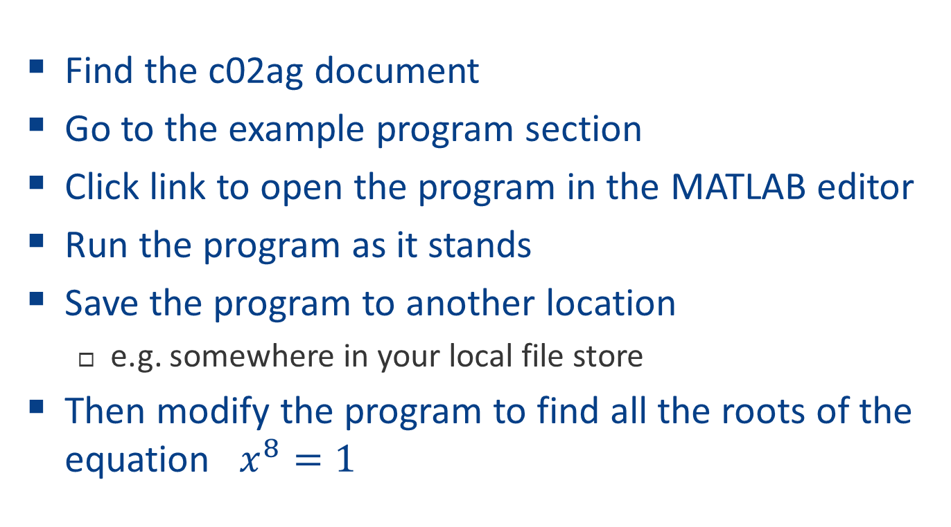
Try the c02ag example program
Find the c02ag document
Go to the example program section
Click link to open the program in the MATLAB editor
Run the program as it stands
Save the program to another location
  e.g. somewhere in your local file store
Then modify the program to find all the roots of the equation $x^{8}=1$

Slide 27
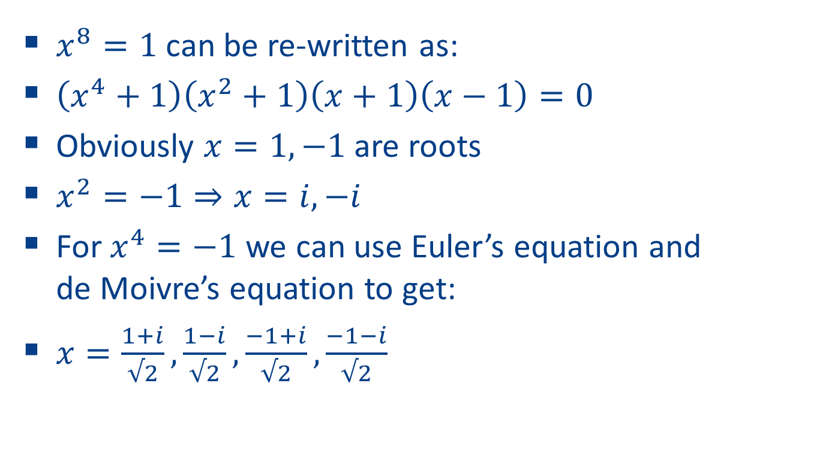
What do we expect
$x^{8}=1$ can be re-written as:
$\left(x^{4}+1\right)\left(x^{2}+1\right)\left(x+1\right)\left(x−1\right)=0$
Obviously $x=1,−1$ are roots
$x^{2}=−1⇒x=i,−i$
For $x^{4}=−1$we can use Euler’s equation and
de Moivre’s equation to get:
$x=\frac{1+i}{√2},\frac{1−i}{√2},\frac{−1+i}{√2},\frac{−1−i}{√2}$

Slide 28
Optional Arguments
Optional arguments are provided after all compulsory arguments.
Optional arguments appear in pairs: a string representing the name followed by the value.
The pairs can be provided in any order.
There are optional arguments where:
  A sensible default value exists which applies to many problems.
  The argument only applies to some cases.
  The value of the argument can normally be determined from that of other arguments at runtime.

Slide 29
Optional arguments
For example, in the system of equations given in the previous section, it is obvious that n, the size of the matrix A, is 4.
However we can tell MATLAB that n is 3, in which case it will solve the system represented by the top-left 3x3 section of A, and the first three elements of b.
And so we would call like this …

Slide 30
Optional arguments
The last element of x can (should) be ignored. Since b was a 4x1 matrix on input, it will be a 4x1 matrix on output, even though the last element is not being used.
[lu, ipiv, x, info] = f07aa(a, b, 'n', nag_int(3));
x
x =
4.1631
-2.1249
3.9737
-6.2200

Slide 31
Arguments
A similar outcome can be achieved by:
Here x is of appropriate size.
[lu, ipiv, x, info] = f07aa(a(1:3,1:3), b(1:3));
x
x =
4.1631
-2.1249
3.9737

Slide 32
Another Example – Overriding Defaults
g01hb (nag_stat_prob_multi_normal) computes probabilities associated with a multivariate Normal distribution, to a relative accuracy which defaults to 0.0001:
xmu = [0;0;0;0]; a = [-2;-2;-2;-2]; b = [2;2;2;2];
sig = [1,0.9,0.9,0.9; % Variance-covariance matrix
0.9,1,0.9,0.9;
0.9,0.9,1,0.9;
0.9,0.9,0.9,1];
nag_stat_prob_multi_normal(xmu,sig,'a',a,'b',b)
ans = 0.9142
We can vary tol:
nag_stat_prob_multi_normal(xmu,sig,'a',a,'b',b,'tol',0.1)
ans = 0.9182

Slide 33
Errors and Warnings
NAG toolbox routines can produce a number of errors (names are on the next slide)
In most cases the error message will give more precise details of how the error was triggered. For example a NAG:arrayBoundError might display the message:
??? The dimension of argument 2 (A) should be at least 4

Slide 34
Errors and Warnings
  NAG:arrayBoundError - Array provided is too small.
  NAG:callBackError - An error occurred when executing an M-File passed as a parameter to the routine.
  NAG:missingInputParameters
  NAG:optionalParameterError - Not in name/value pairs, or the name provided is not an optional parameter.
  NAG:tooManyOutputParameters
  NAG:typeError - A parameter is of the wrong type.
  NAG:unsetCellArrayError - A cell array has been passed without all elements being set.
  NAG:valueError - An incorrect value has been provided for a parameter.
  NAG:licenceError - A valid licence couldn’t be found.

Slide 35
Errors and Warnings
The NAG routines can produce two warnings:
  NAG:truncationWarning - A string was truncated when copying cell array of strings to a Fortran data structure.
  NAG:warning - The NAG routine returned an error or warning.
The latter is important, and means that on exit the value of the argument ifail (or, in chapters f07 and f08, info) was non-zero on exit.
For details about how to interpret this value the user should consult the Error Indicators and Warnings section of the document for the particular routine.

Slide 36
Errors and Warnings
If you do not wish to see a warning then you can disable it in the usual MATLAB way, for example:
warning('off', 'NAG:warning')
In this case it is vital that you check the value of ifail or info on exit from the routine.

Slide 37
Turning NAG warnings on and off
warning('on', 'NAG:warning'); % Turn warnings on
a = [1 2; 2 4]; % N.B. a is a singular matrix
b = [1; 1];
[lu, ipiv, x, info] = f07aa(a,b); % Try to solve equations
Warning: nag_lapack_dgesv (f07aa) returned a warning indicator (2)
warning('off', 'NAG:warning'); % Turn warnings off
[lu, ipiv, x, info] = f07aa(a,b); % Try to solve equations
if (info ~= 0) % Must check info
'a warning occurred'
else
'everything OK'
end

Slide 38
Types
The interfaces to NAG routines in the Toolbox are quite precise about the types of their arguments.
Since MATLAB assumes by default that every number is a double users need to convert their input data to the appropriate type if it is an integer, a complex number or a logical.
Similarly, in M-Files called by a NAG routine, the user must ensure that the results returned are of the appropriate type. This is to ensure the correct alignment between the MATLAB and Fortran types.

Slide 39
MATLAB Data Types - Complex
The complex function constructs a complex result from real and imaginary parts.
The statement
c = complex(x,y)
returns the complex result x + yi, where x and y are identically sized real arrays or scalars of the same data type.
y is optional, and without this argument a complex variable is retuned with zero imaginary part.
You can test a variable with the isreal function, which returns false if the variable is complex.

Slide 40
MATLAB Data Types - Integers
There are also 8 integer data types in MATLAB:
int8, int16, int32, int64,
uint8, uint16, uint32, uint64
The number refers to the number of bits that are used to store the value. uint* are unsigned integers.
For example the int32 function: myint = int32(n)
You can find the range of values supported by these data types with intmin and intmax:
>> [intmin(‘int8’) intmax(‘int8’)]
ans =
-128 127

Slide 41
Integers
Integers used by the NAG Toolbox are chosen to be compatible with those used internally by MATLAB, and will be int32 or int64

Slide 42
Integers
For portability across versions of the Toolbox that use both 32 and 64 bit integers we provide two functions:
  nag_int(x) - converts x to the integer type compatible with the current version of the NAG toolbox
  nag_int_name - returns the name of the integer class compatible with your version of the NAG toolbox
>> a = nag_int(3)
a = 3
>> nag_int_name()
ans = int64
>> b = zeros(10, nag_int_name());
>> whos
Name Size Bytes Class Attributes
a 1x1 8 int64
ans 1x5 10 char
b 10x10 800 int64

Slide 43
MATLAB Data Types - Logical
Logical data types:
>> a = true; b = false; a | b
ans =
1
In many areas of MATLAB we can use integers interchangeably with logical variables - in an if test for example.
However to create a logical from other datatypes, use the logical function mylog = logical(0)
This returns true for all but variables with value zero.

Slide 44
Creating variables of correct type
nag_int(1) - to create an integer with value 1
complex(1,1) - to create 1.0000 + 1.0000i
logical(0) - to create a logical that is .FALSE.
If an object of the incorrect type is provided then a NAG:typeError will be thrown:
s01ea(0)
??? argument number 1 is not a complex scalar of class double.
s01ea(complex(0))
ans = 1.0000 + 0.0000i

Slide 45
Providing m-files as arguments
Many NAG routines allow the user to provide an m-file to evaluate a function, which might represent an integrand, or the objective function in an optimization problem, etc.
Here is an example showing how to compute a definite integral; 'd01ah_f' is the name of an m-file which evaluates the integrand:
d01ah(0, 1, 1e-5, 'd01ah_f', nag_int(0))
ans =
3.1416

Slide 46
Providing m-files as arguments
In this case 'd01ah_f.m' contains:
function [result] = d01ah_f(x)
result = 4.0/(1.0+x^2);
For every instance where a NAG routine expects an M-File to be provided, an example is given.
Function handles can also be used.

Slide 47
Function handles
These are useful in three main circumstances:
  when the argument is an existing MATLAB command
  when the argument is a simple expression returning one value which can be represented as an anonymous function
  when the argument is a function that is local to an m-file.
So we could have, for example, definite integrals:
  nag_quad_1d_fin_well(0, pi, 1e-5, @sin, nag_int(0))
  [result, abserr] = ...
  d01aj(@(x) 4.0/(1.0+x^2), 0, 1, 1e-5, 1e-5)

Slide 48
User Data Arguments
Sometimes you may need to pass data to be used by a ‘callback’ routine via a ‘user’ parameter:
x = [0.5; 1; 1.5];
mydata = [0.14,0.18,0.22,2.10,4.39];
[xOut, fsumsq] = e04fy(nag_int(15), ... 'e04fy_lsfun1', x, 'user', mydata);
The data in ‘mydata’ is then passed on to e04fy_lsfun1.m

Slide 49
Functionality and DEMOS:
Curve and surface fitting

Slide 50
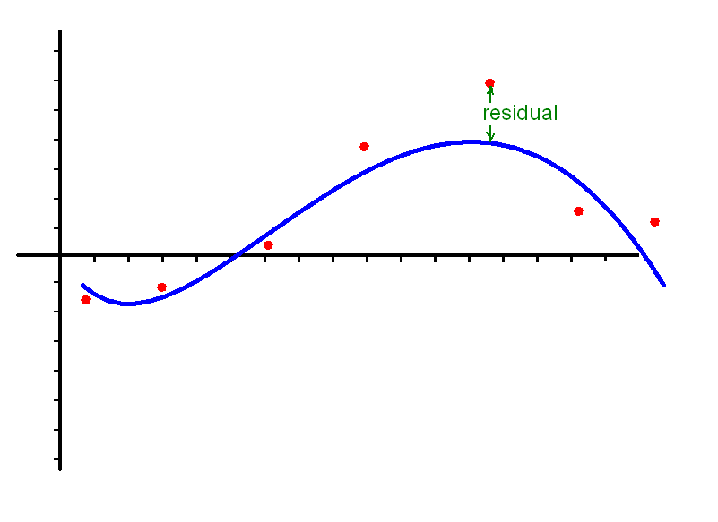
Chapter e02 – Curve and Surface Fitting
Problem to solve: given a set of data points, find the value of a function at points other than the data
Unlike with interpolation, fitted function need not pass through data points
Typically, data contain random errors (e.g. from experimental measurement) – so interpolation is not appropriate
Smoothness of fitting function is likely to be desirable

Slide 51
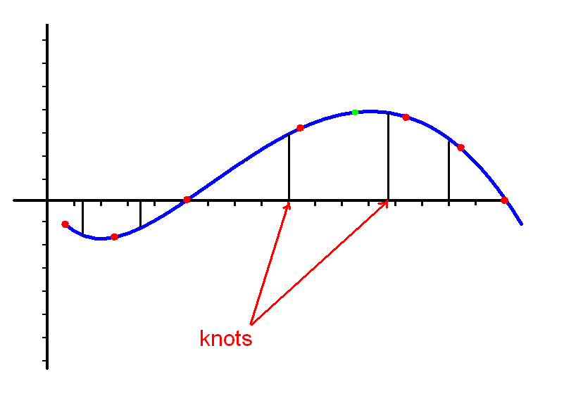
e02 – Curve and Surface Fitting
Piecewise polynomial splines are useful.
Segments are joined with first and second derivative continuity at the joins (knots).

Slide 52
Chapter e02
Data fitting usually involves minimizing the norm of the residuals
  e.g. minimize largest residual
  or minimize sum of squares of residuals
Data points may be weighted according to their importance – bigger weight = more confidence
Splines play an important role
  Choice of knots may be crucial
  Some routines are automatic – no need to choose knots
Spline representation:
f(x) = c₁N₁(x) + c₂N₂(x) + … + c_{p}N_{p}(x)
where N_{i}(x) is a normalized cubic B-spline

Slide 53
Fitting examples – e02be and e02dc
e02be/e02dc compute spline approximations to sets of data values, given on an interval (1D) or rectangular grid in the x-y plane (2D).
The knots (where the individual splines meet) of the spline are located automatically.
A single argument, s, is specified to control the trade-off between closeness of fit and smoothness of fit. “Small” s closer fit.
In theory, a value of s = 0 will produce an interpolating spline.
< run e02be and e02dc demos here>

Slide 54
Functionality and DEMOS:
Optimization

Slide 55
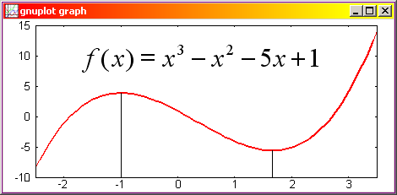
What do we mean by “Optimization”?
For our purposes we mean “given a scalar real-valued mathematical function of n variables x_{i}, find values of the variables x that make the function as small (or as large) as possible”

Slide 56
How do we do it?
We systematically choose values of the variables x_{i} from within the set of values that are allowed.
Sometimes all values are allowed (unconstrained optimization)
Sometimes some values are forbidden (constrained optimization)
  e.g. -3 <= x₁ <= 3 or x₂ > 0
Typically the user must supply a starting point x

Slide 57
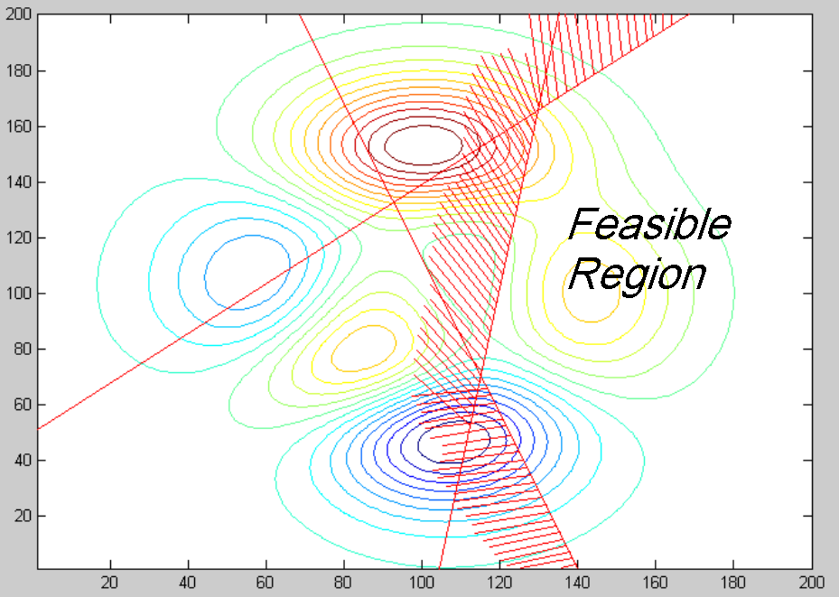
Linearly constrained optimization

Slide 58
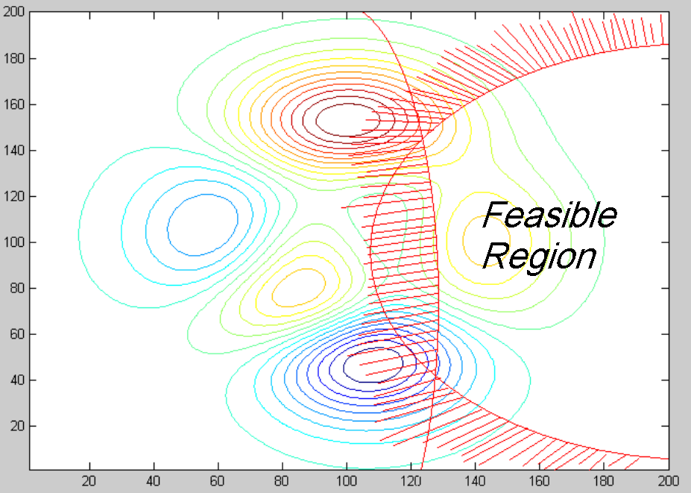
Optimization - Nonlinear Constraints
58

Slide 59
e04 Routine Classification
Number of variables:
  Single variable f(x)
  Multiple variable f(x)
Type of objective:
  Linear
  Quadratic or sum of squares
  Nonlinear
Constraints:
  None
  Simple bounds
  Linear
  Nonlinear

Slide 60
Are derivatives necessary?
<run steepest_descent_demo and e04uc_demo here>
Some algorithms require them
Some don’t
Some prefer them but can manage without
  They may use finite difference estimates

Slide 61
NAG Optimization
Problems categorized according to properties of objective function:
  linear
  nonlinear
  sum of squares of nonlinear functions
  quadratic
It is important to choose a method appropriate to your problem type, for efficiency and the best chance of success.

Slide 62
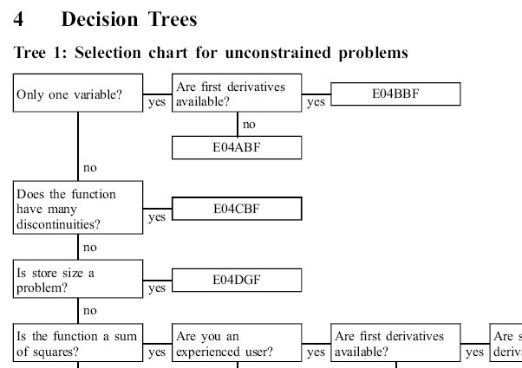
Best Advice – Use the Decision Trees

Slide 63
Run the e04uc demo yourself
Go to the NAG Toolbox demos page in MATLAB
Find Minimization (e04uc_demo) and click the ‘Run’ link
Try adding linear constraints
  Click twice on the contour plot to set a line
  Click once more to determine which side of the line is feasible (the other side will turn yellow)
Change the function from Rosenbrock to Peaks
Try using various different starting points and observe what happens

Slide 64
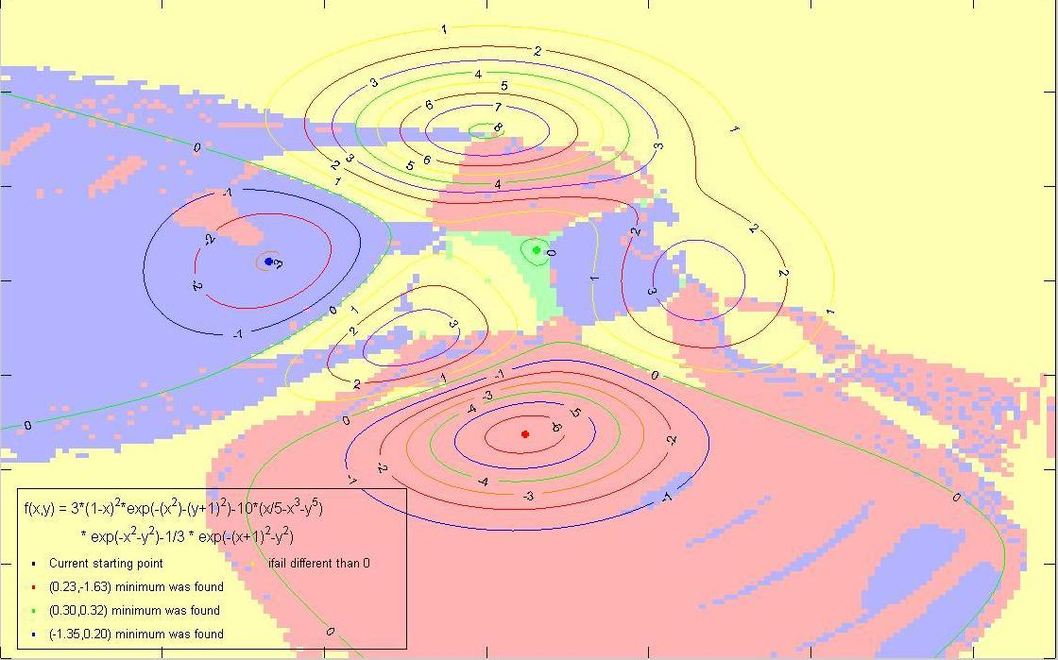
Problem with local optimization

Slide 65
Hence - Global Optimization
Maybe try the demo Global_Minimization (e05jb_demo)
Multilevel Coordinate Search
  MCS - a “box splitting” method
  Arnold Neumaier (Vienna)
Particle Swarm Optimization
  No assumptions about differentiability etc.
  No guarantees about finding optimal solution
  Can be useful for “noisy” problems
Multi-Start e05uc
  Choose a large set of start positions depending on problem size and how many threads available
  Based on solid foundation of local optimizer e04uc

Slide 66
Continue with exercises
Try more questions from the exercise sheets

Slide 67
Functionality and DEMOS:
Random numbers

Slide 68
Chapter g05 – Random Numbers
Random numbers – used to model real-life processes.
Humans are bad at choosing them.
e.g. faking a random sequence of coin tosses is very difficult: HTHHTHTTHTHHTTTHTTHHTTHTHHTHTH …
Most people would choose a sequence easily proved not to be random
Therefore good algorithms are required.

Slide 69
Chapter g05 – Random Numbers
Random numbers from non-uniform distributions
Generated from uniform numbers
  Transformation methods
  Rejection methods
  Table search methods
Normal (Gaussian) distribution
Student’s t distribution
Beta and Exponential
Chi-Squared and Binomial
Geometric, Poisson, F, Gamma, …

Slide 70
Pseudo- versus Quasi-Random Numbers
Pseudo-random numbers:
generated systematically
  e.g. multiplicative congruential n_{i} = a n_{i-1} mod m
properties close to true random numbers
  (assuming that a and m are chosen wisely)
negligible correlation between consecutive numbers
Quasi-random numbers:
not statistically independent
give more even distribution in space (“looks more random”)
useful for Monte Carlo integration

Slide 71
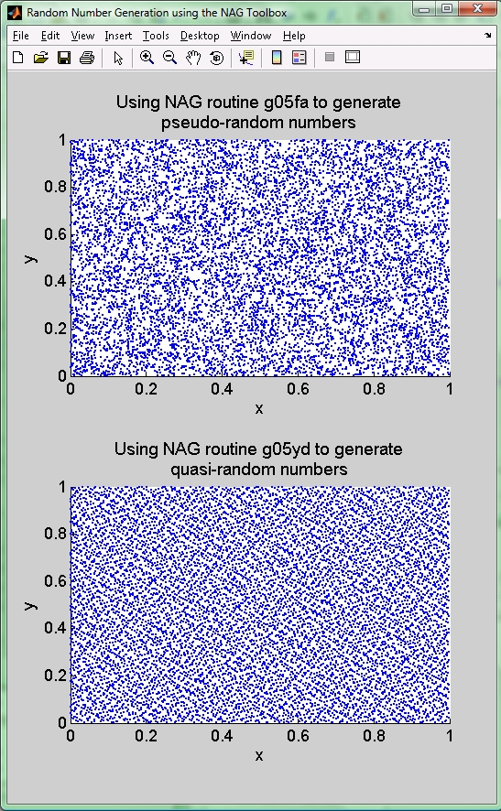
Pseudo- versus Quasi-Random Numbers
Core MATLAB only has pseudo random numbers
NAG Toolbox has pseudo and quasi
This shows the difference:
<run quasi_integral here>

Slide 72
Mesh generation / PDE solution app
In the NAG demo list, find the ‘Mesh Generation’ app (it is at the bottom of the list of demos)
Run the app (you will probably need to read the documentation too!)

Slide 73
exampleS:
Nearest Correlation Matrix

Slide 74
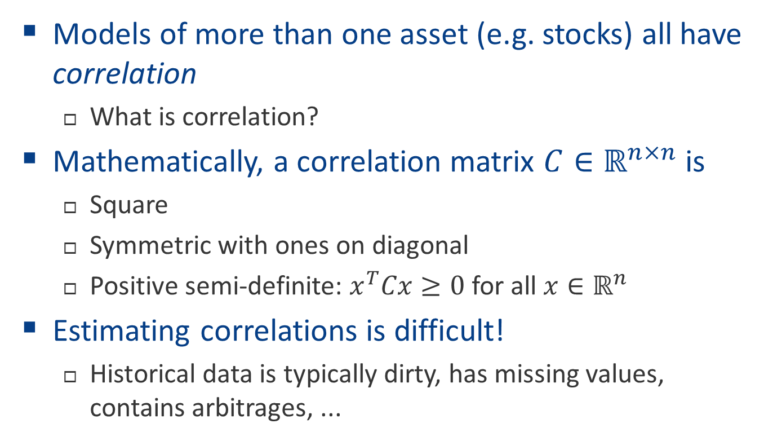
Nearest Correlation Matrix
Models of more than one asset (e.g. stocks) all have correlation
  What is correlation?
Mathematically, a correlation matrix $C∈ℝ^{n×n}$ is
  Square
  Symmetric with ones on diagonal
  Positive semi-definite: $x^{T}Cx≥0$ for all $x∈ℝ^{n}$
Estimating correlations is difficult!
  Historical data is typically dirty, has missing values, contains arbitrages, ...

Slide 75
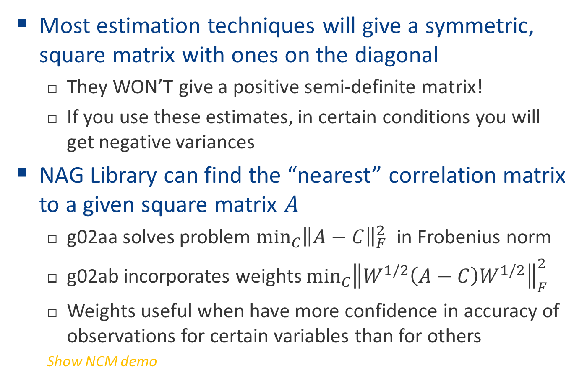
Nearest Correlation Matrix
Most estimation techniques will give a symmetric, square matrix with ones on the diagonal
  They WON’T give a positive semi-definite matrix!
  If you use these estimates, in certain conditions you will get negative variances
NAG Library can find the “nearest” correlation matrix to a given square matrix $A$
  g02aa solves problem ${\text{min}}_{C}{{\left\|A−C\right\|}_{F}^{2}}$ in Frobenius norm
  g02ab incorporates weights ${\text{min}}_{C}{{\left\|W^{1/2}\left(A−C\right)W^{1/2}\right\|}_{F}^{2}}$
  Weights useful when have more confidence in accuracy of observations for certain variables than for others
  Show NCM demo

Slide 76
Various other demos in the NAG Toolbox
Including:
Root finding
Quadrature
Global optimization
Time Series

Slide 77
Continue with exercises
Try the ODE IVP question if you haven’t already

Slide 78
Other versions of NAG Libraries
NAG C/C++ Library
NAG Fortran Library
NAG C# / .NET Library
Also callable from
  Microsoft Excel
  Visual Basic
  Java
  Python
  … and others

Slide 79
Hands-on exercise material
Exercise questions can be found here:
http://monet.nag.co.uk/nag_toolbox_training/MATLAB/toolbox_questions
Start off with the first question sheet – short questions
Try whichever you like
Work alone or in pairs if you prefer

